Slide 1
Tools of the Agile Developer
Michael Kreeger

Slide 2

about me
My passions are agile, software craftsmanship, building teams, unit testing, design, architecture, best practices, DDD… I love software development
Lots of different roles over the years….
Development Manager
Solutions Architect
Feature development
DevOps
Special operations / technical swat team
Developer evangelist
…and I have eight kids

Slide 3
Agenda
Agile Manifesto
12 Agile Principles
State of the Software Craft Today
Agile Development of the Future

Slide 4
the best agile tool of all
Agile Manifesto

Slide 5
Agile Manifesto
We are uncovering better ways of developing software by doing it and helping others do it.

Slide 6
Agile Manifesto
We are uncovering better ways of developing software by doing it and helping others do it.
Kent Beck Mike Beedle Arie van Bennekum Alistair Cockburn Ward Cunningham Martin Fowler | James Grenning Jim Highsmith Andrew Hunt Ron Jeffries Jon Kern Brian Marick | Robert C. Martin Steve Mellor Ken Schwaber Jeff Sutherland Dave Thomas

Slide 7
Agile Manifesto
We are uncovering better ways of developing software by doing it and helping others do it.
Kent Beck Mike Beedle Arie van Bennekum Alistair Cockburn Ward Cunningham Martin Fowler | James Grenning Jim Highsmith Andrew Hunt Ron Jeffries Jon Kern Brian Marick | Robert C. Martin Steve Mellor Ken Schwaber Jeff Sutherland Dave Thomas

Slide 8
Agile Manifesto
We are uncovering better ways of developing software by doing it and helping others do it.
This is ongoing, it is not we have uncovered …
Agile developers are practicing their craft and helping other developers do agile development

Slide 9
Agile Manifesto
Through this work we have come to value:

Slide 10
Agile Manifesto
Individuals and interactions over processes and tools
Agile developers seek conversations with those they are trying to help
Avoid putting processes in between developers and the people they should be talking to…. even a PO. Avoid telephone game.
Agile developers don’t like tools that get in the way of working with people

Slide 11
Agile Manifesto
Working software over comprehensive documentation
#1 Our highest priority is to satisfy the customer through early and continuous delivery of valuable software.
#3 Deliver working software frequently, from a couple of weeks to a couple of months, with a preference to the shorter timescale.
#7 Working software is the primary measure of progress.

Slide 12
Agile Manifesto
Working software over comprehensive documentation
Agile developers care deeply that their code works.
Agile developers go to great lengths ensure their code works.
Unit, Integration, Behavior, UI Tests, Manual Tests
TDD
Design Patterns
Resilient Architectures
Automation
Agile developers are constantly refining their craft and reducing the likelihood that bugs are found within their software…especially QA
Monitor how many bugs are found

Slide 13
Agile Manifesto
Working software over comprehensive documentation
Agile developers maintain the bare minimum of documentation.
Stop handing off products eliminates a ton of documentation.
Well written code eliminates a ton of code comments.
Documentation on how to use an application implies its not intuitive
Documentation in code implies the code is confusing and possibly should be refactored
…not no documentation but again….bare minimum

Slide 14
Agile Manifesto
Customer collaboration over contract negotiation
Agile developers build relationships instead of detailed specifications.
Agile developers are focused on understanding and solving problems.
Agile developers are okay operating with unknown details. They treat unknown details just like they would known details. Both are best guesses that we make with the customer.

Slide 15
Agile Manifesto
Responding to change over following a plan

Slide 16
Agile Manifesto
Responding to change over following a plan
#2 Welcome changing requirements, even late in development. Agile processes harness change for the customer's competitive advantage.

Slide 17
Agile Manifesto
Responding to change over following a plan
Agile developers write code that can change easily and safely
Unit, Integration, Behavior, Functional, UI, etc….tests, tests, tests
High Cohesion
the degree to which the elements of a module belong together
Low Coupling
the manner and degree of interdependence between software modules
OOP - SOLID Design
Responsibility – a reason for change
SRP – Single Responsibility Principle
SRP – Single Reason to Change Principle
Automation
Rapid Deployments
Agile developers don’t waste time trying to make the right choices (planning), they instead design systems that allow those choices to be changed.

Slide 18
Agile Manifesto
Responding to change over following a plan
Agile architecture allows for change
“A good architect maximizes the number of decisions not made.”

Slide 19
branching
Why is this important?
Agile principle #3
Deliver working software frequently, from a couple of weeks to a couple of months, with a preference to the shorter timescale.
Branching done wrong fights continuous integration, leads to merge hell, hurts velocity, … is not agile

Slide 20
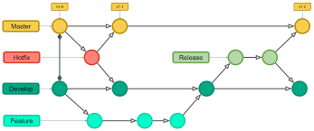
branching

Slide 21
branching
What’s wrong with git flow?
Feature branches are long lived (terminology warning). They bury risk by avoiding merges and delay pushing to production.
This fights CI efforts.
Development branches give developers a false sense that they can commit half baked code.
Merge hell
Complicated
Promotes big batches / long release cycles

Slide 22
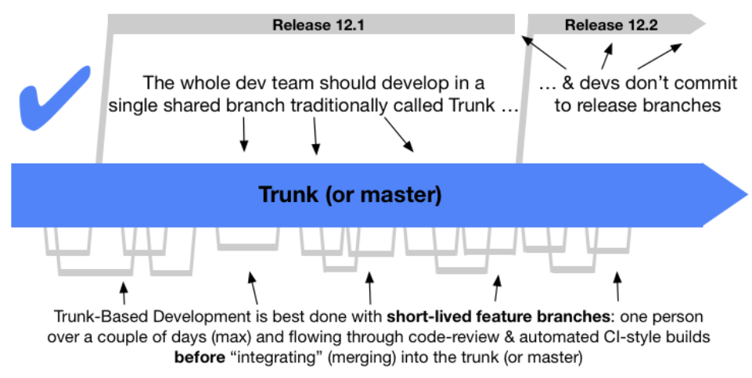
branching
What is trunk based development?

Slide 23
branching
What’s right with trunk based development?
Short lived feature (a.k.a. story branches) are short lived.
Code is merged frequently and risk isn’t buried.
This encourages CI.
Master is a release candidate. No false sense of “sloppy is okay” in a development branch.
Reduce merge hell
Simple
Promotes faster iterations / release cycles

Slide 24
branching
Accelerate 2018
key characteristic of high performing teams
Current branching strategy used by most industry leading IT organizations (Google, Facebook, Amazon, Microsoft, etc.)
Trunk based development helps teams iterate faster

Slide 25
branching
Long lived feature branches are a bad way to manage risk or releases.
Story branches are a good way to collaborate on a story or iterate on an idea.

Slide 26
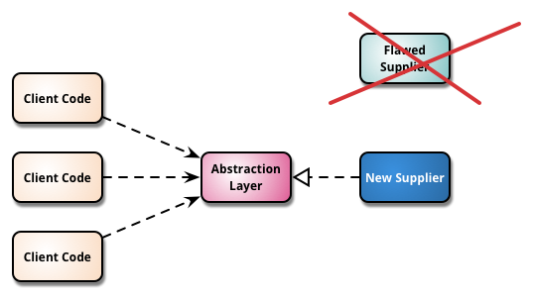
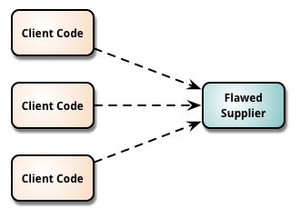
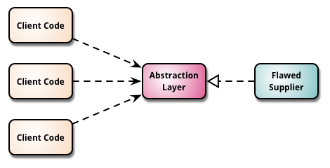
branching
How to deploy without releasing
Feature toggles
Allows for code to be deployed to production but have features turned off / hidden.
Branch by abstraction / strangler pattern
Injects a layer of abstraction in between two components to allow communication between them to be re-routed to newer components gradually, iteratively, when desired.

Slide 27
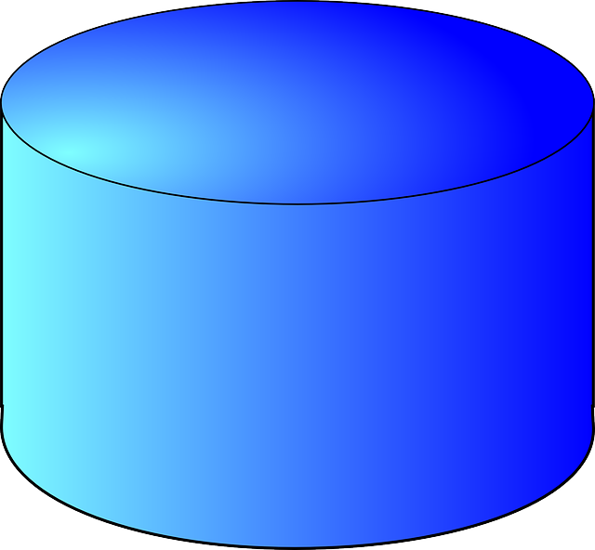
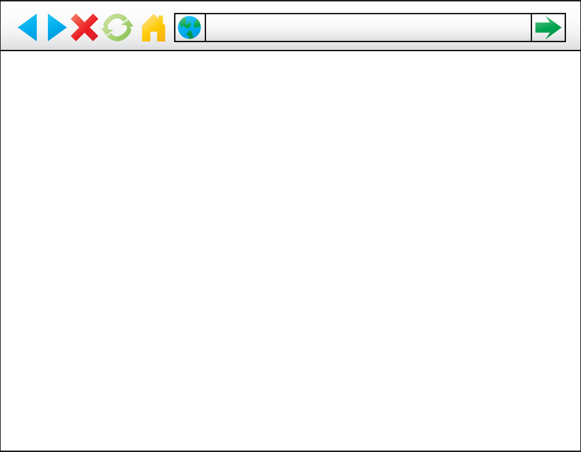
branching
How to deploy without releasing
Open Closed Principle (OCP) - Additive approach to change
API v1
UI v1
Stored Procedure v1
API v2
Stored Procedure v2
UI v2

Slide 28
branching
Agile developers love TBD (trunk based development)

Slide 29
branching
Where this is going…

Slide 30
branching
Is hotfixes needed?
Hot Fixes
Deployment Frequency

Slide 31
branching
References
Trunk Based Development:
Accelerate: The Science of Lean Software and DevOps: Building and Scaling High Performing Technology Organizations
https://www.infoq.com/news/2018/04/trunk-based-development/
https://dzone.com/articles/googles-scaled-trunk-based
https://www.endoflineblog.com/gitflow-considered-harmful
Feature toggles
https://www.martinfowler.com/articles/feature-toggles.html
https://launchdarkly.com
Branch by abstraction
https://www.martinfowler.com/bliki/BranchByAbstraction.html
https://trunkbaseddevelopment.com/branch-by-abstraction/
Strangler pattern
https://docs.microsoft.com/en-us/azure/architecture/patterns/strangler

Slide 32
automated testing
Why is this important?
Software has to work, change, be designed well, be as simple as possible, etc.
Agile Manifesto
Working software over comprehensive documentation
Responding to change over following a plan
Agile Principles
Agile principle #1 - Our highest priority is to satisfy the customer through early and continuous delivery of valuable software.
Agile principle #2 - Welcome changing requirements, even late in development. Agile processes harness change for the customer's competitive advantage.
Agile principle #3 - Deliver working software frequently, from a couple of weeks to a couple of months, with a preference to the shorter timescale.
Agile principle #7 - Working software is the primary measure of progress.
Agile principle #9 - Continuous attention to technical excellence and good design enhances agility.

Slide 33
automated testing
Finds bugs in the earlier stages of development
Improves accuracy
Saves time and money
More reliable
Quality of code
Facilitates change
Simplifies integrations
Provides documentation
Reduces costs
Inspire confidence

Slide 34
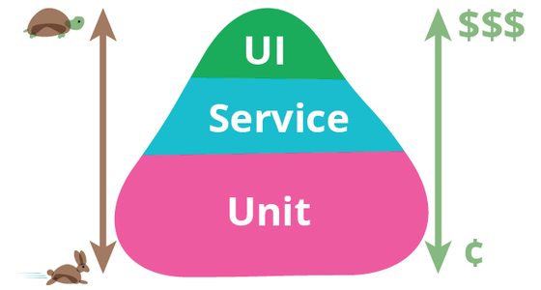
automated testing
Fundamentals

Slide 35
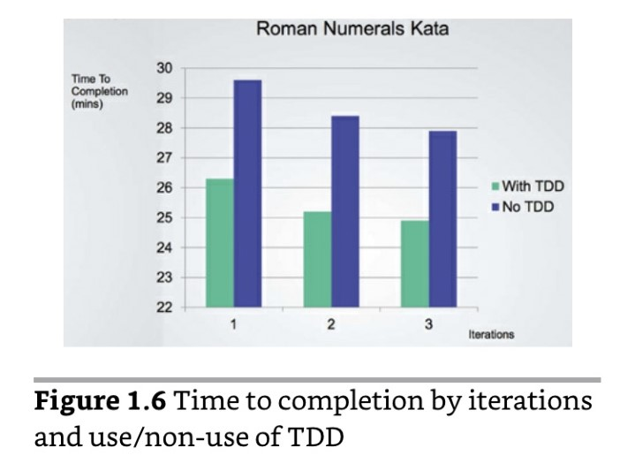
automated testing
Robert Martin
The only way to go fast is to go well
Jason Gorman

Slide 36
automated testing
Robert Martin
The only way to go fast is to go well
Jason Gorman

